Slide 1
Introduction to HTML & HTML Tags

Slide 2
What is HTML?
HTML stands for HyperText Markup Language.
It defines the structure and content of web pages.
Invented by Tim Berners-Lee in the late 1980s. Think of HTML as the skeleton of a webpage, providing the basic structure and organization.
It's not about fancy visuals, but about creating a framework for text, images, and other elements.
Tim Berners-Lee, a visionary computer scientist, laid the foundation for the web with his creation of HTML.

Slide 3
Hypertext Non-linear Navigation with Hypertext
Hypertext allows for jumping between connected pages.
Links act as signposts guiding users through information.
Enables non-sequential exploration of the web.
Imagine the web as a giant library, but instead of flipping through pages, you can click on highlighted words to instantly access related information.
This interconnectedness is the beauty of hypertext, making the web an information powerhouse.
Links are the magic glue that binds the web together, allowing users to navigate freely and efficiently.

Slide 4
Markup Language Demystifying Markup Languages
Markup languages describe content rather than displaying it.
Use tags to define different elements on a page.
HTML is a specific type of markup language. Speaker Notes:
Don't confuse markup languages with programming languages. Markup languages describe how things are laid out, while programming languages make things happen.
Think of HTML tags like instructions for a builder. They tell the browser what each piece of content is (heading, paragraph, image, etc.).
HTML is just one example of a markup language, but it's the most widely used for building web pages.

Slide 5
Why Use HTML? The Power of HTML in Web Development
Foundation for all websites, from simple to complex.
Lightweight and ensures fast loading times.
Works seamlessly with CSS and JavaScript for styling and interactivity.
Just like any building needs a strong foundation, every website needs HTML as its core.
Its simplicity makes it beginner-friendly but also powerful enough for complex websites.
Remember the saying, "Less is more"? HTML embodies this, ensuring fast loading times for a smooth user experience.
And the best part? HTML plays nicely with other tools like CSS for styling and JavaScript for interactivity, creating a dynamic web experience.

Slide 6
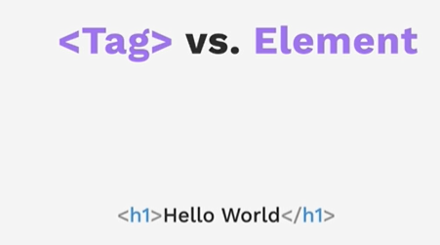

Slide 7
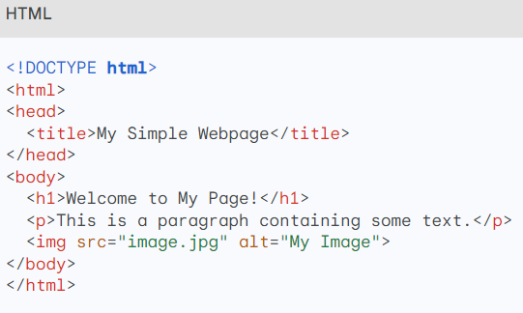
Example HTML Code
The code begins with <!DOCTYPE html>, which declares the document type as HTML.
The <html> tag marks the start of the HTML document.
The <head> section contains information about the webpage, like the title (<title>).
The <body> section contains the visible content of the webpage.
Each element has its own opening and closing tag (e.g., <h1> and </h1>).
The src attribute in the <img> tag specifies the image source.
The alt attribute provides alternative text for accessibility.

Slide 8
Block-level vs. Inline Elements
Block-level Elements: These elements take up the full width available and start on a new line. They create visible "blocks" of content.
Examples: <div>, <p>, <h1>-<h6>, <ul>, <ol>, <li>
Inline Elements: These elements don't start on a new line and only take up as much width as necessary. They can appear within block-level elements.
Examples: <span>, <a>, <strong>, <em>, <i>

Slide 9
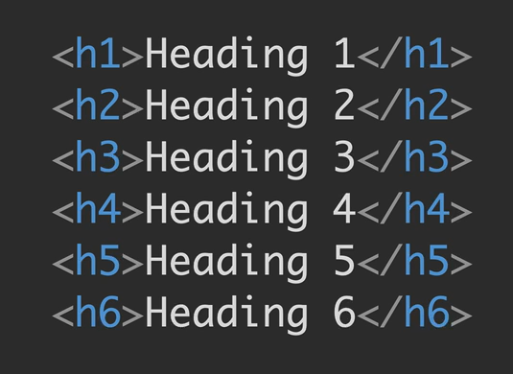
Heading tag

Slide 10
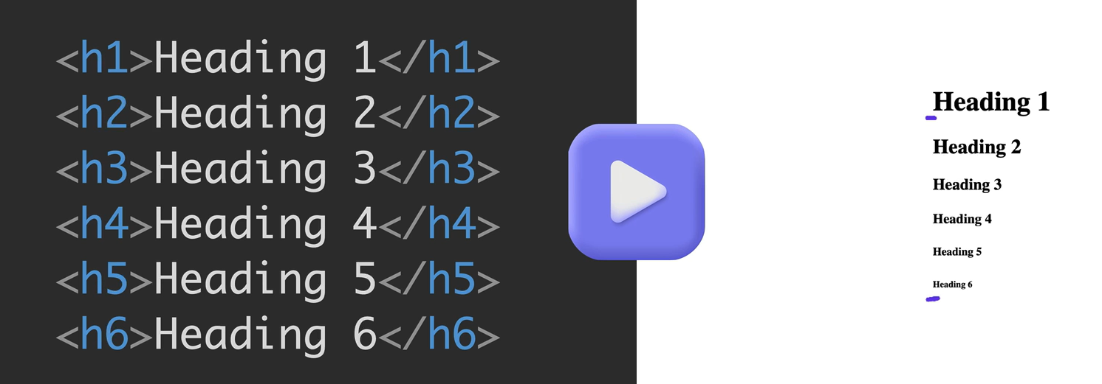
Heading tag

Slide 11
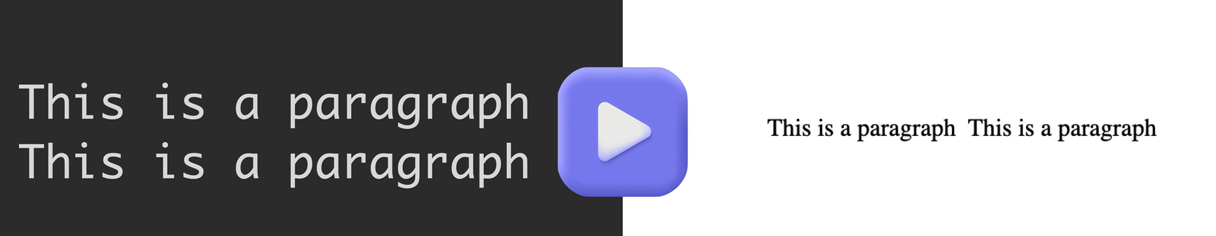
PARAGRAPH TAG

Slide 12
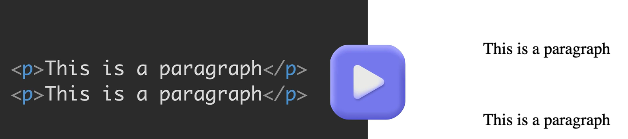
Paragraph Tag

Slide 13
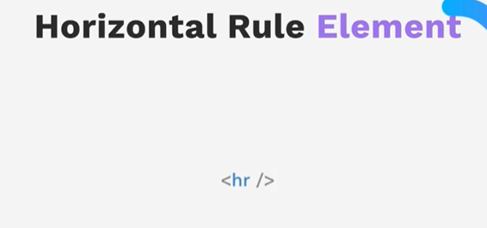
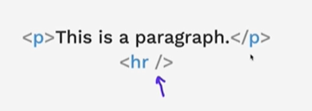
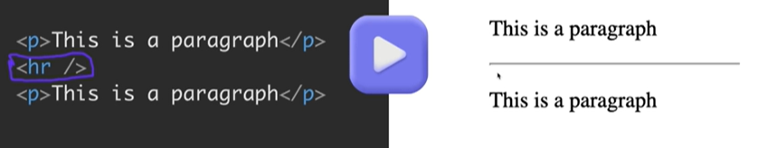
Self-closing tags

Slide 14
Self-closing tags

Slide 15
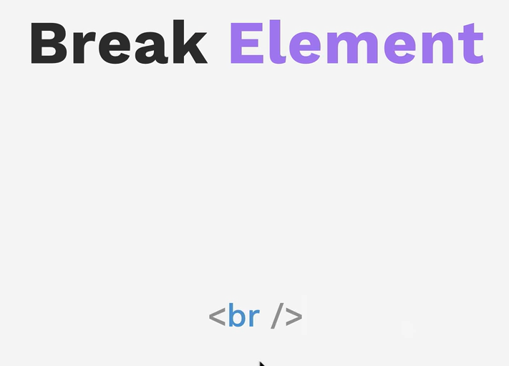
Self-closing tags

Slide 16
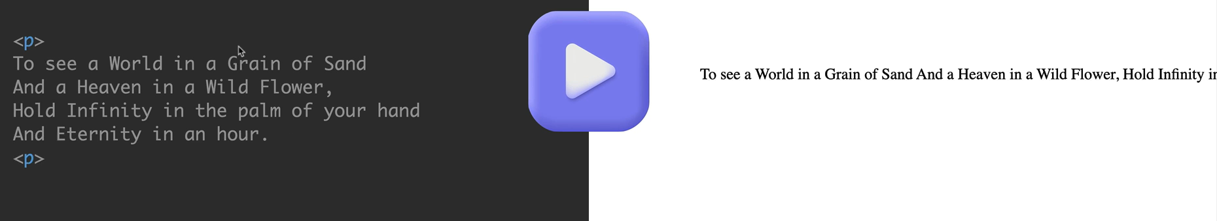
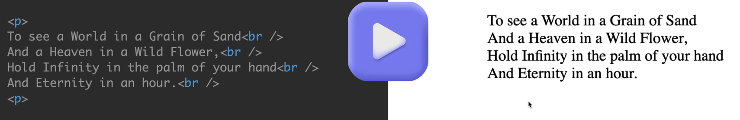
Self-closing tags

Slide 17
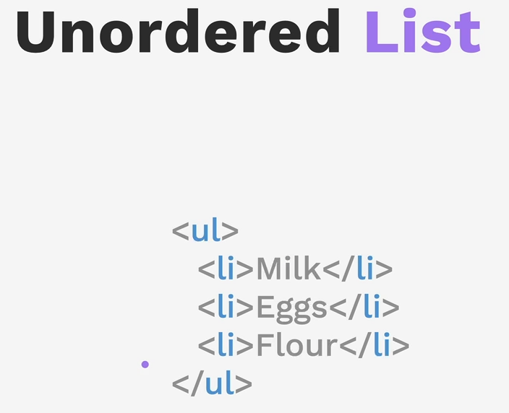

Slide 18
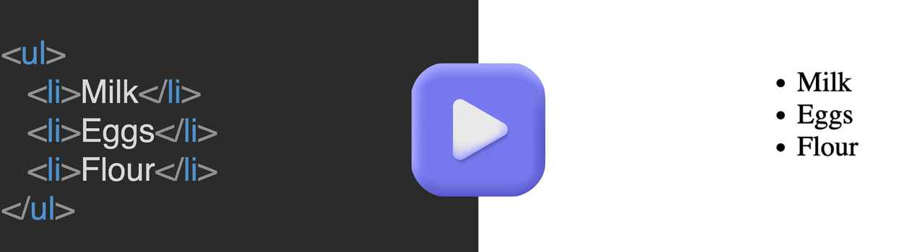

Slide 19
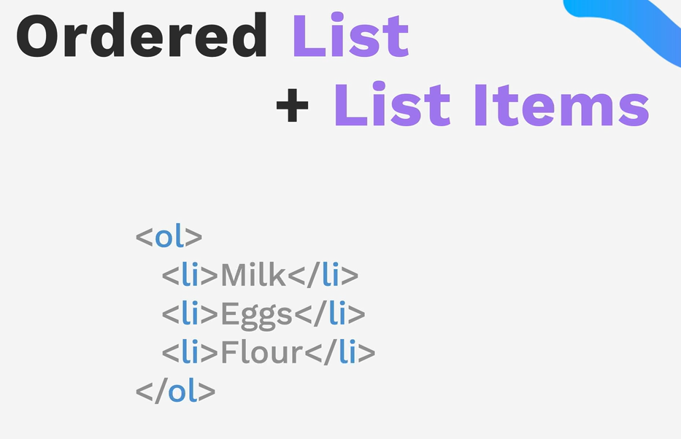

Slide 20
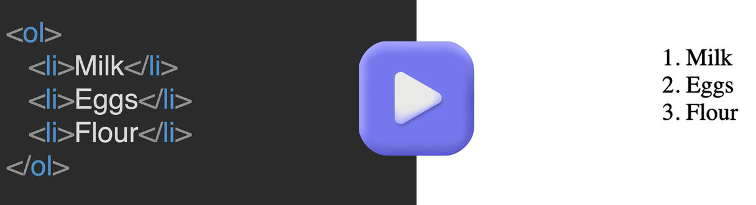

Slide 21
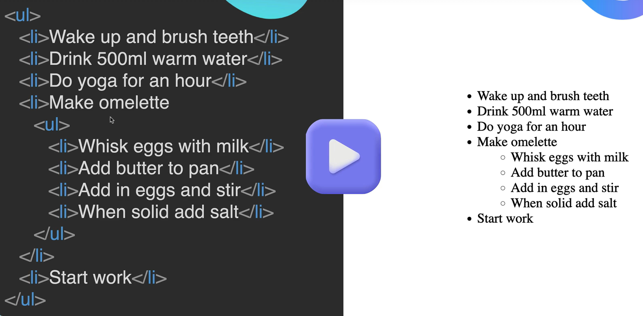

Slide 22
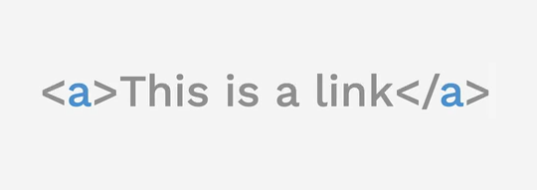
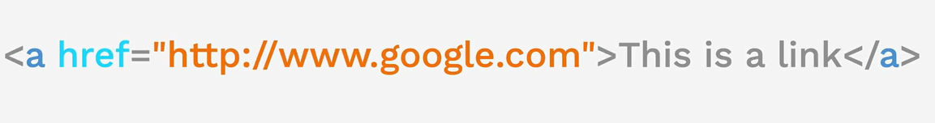
Anchor element

Slide 23
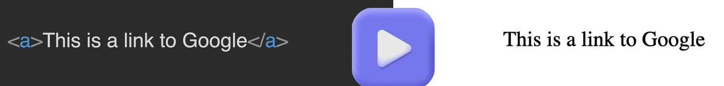
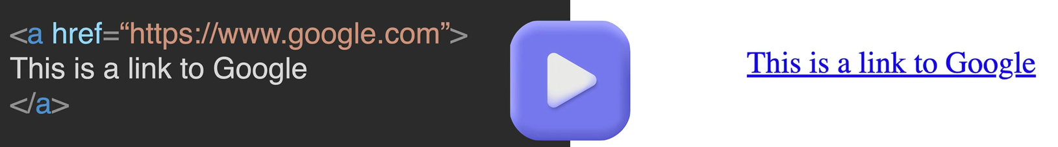
Anchor element

Slide 24
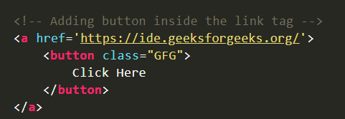
Anchor element

Slide 25
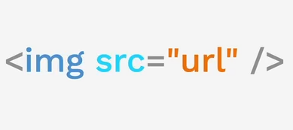
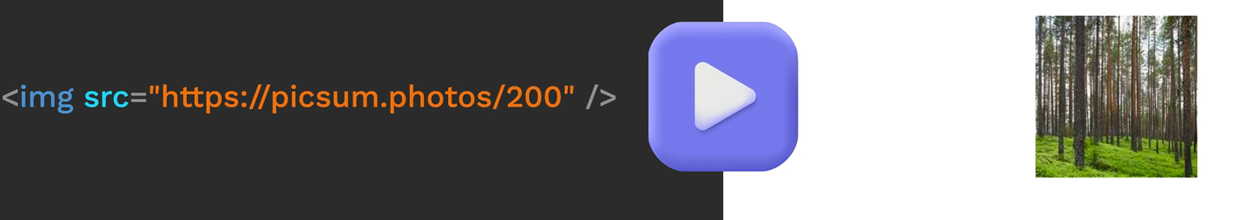
Image element

Slide 26
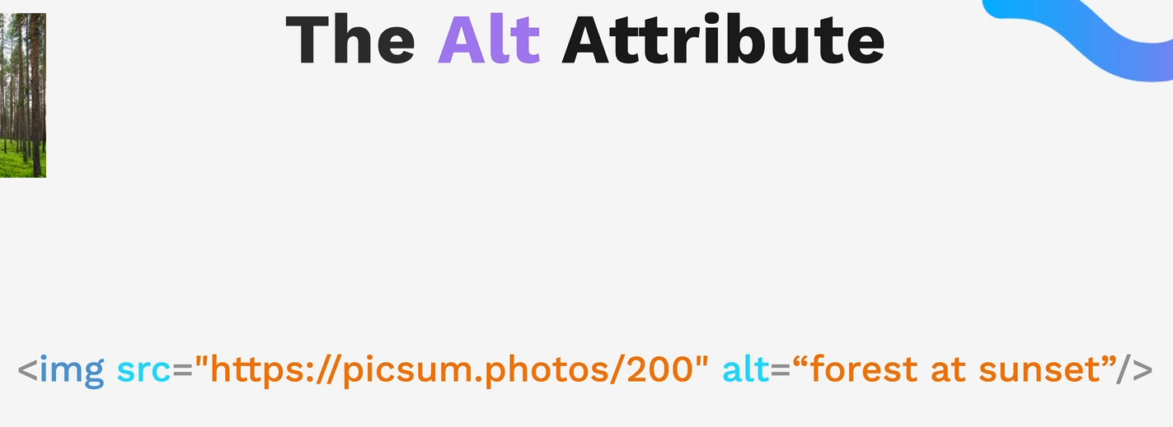
Image element

